Slide 1
IMDB Rating Prediction Final Presentation
Matt Poiesz, Aidan Feeley, Danielle Contreras

Slide 2
Research Question and Goals
Can IMDB ratings for unreleased movies be predicted based on data from previous releases?
With what type of accuracy?
Which model produces the best results?
Which variables have the greatest influence?

Slide 3
Data Scraping Process
Data was scraped from IMDB.com
Each member tried different scraping approaches
745 movies remained after NA values removed
28 categories of data
Decision between more movies or more variables

Slide 4
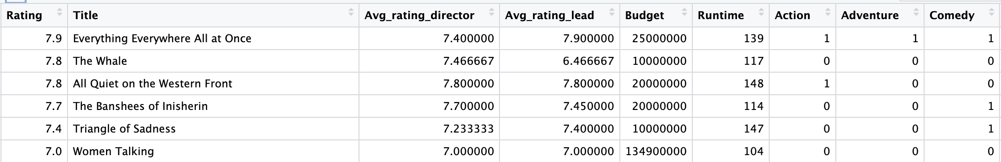
Final Scraping Process
“Advanced Title Search”
2001-2022
All Ratings
>2500 Reviews
Rvest()
Looped through title searches
Manual data entry
Budget
Sequel
Director, Actor names
to
Average ratings

Slide 5
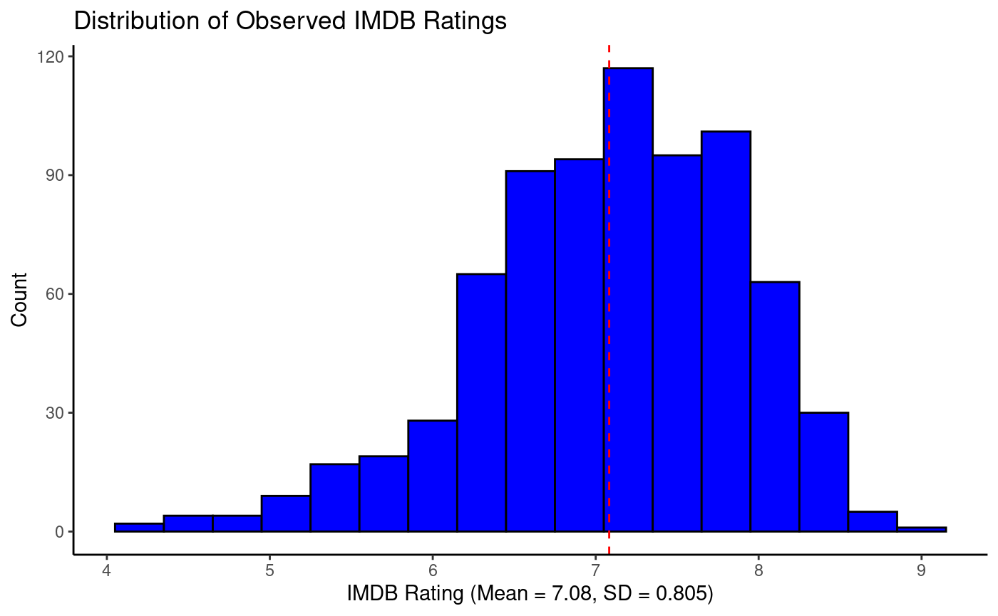
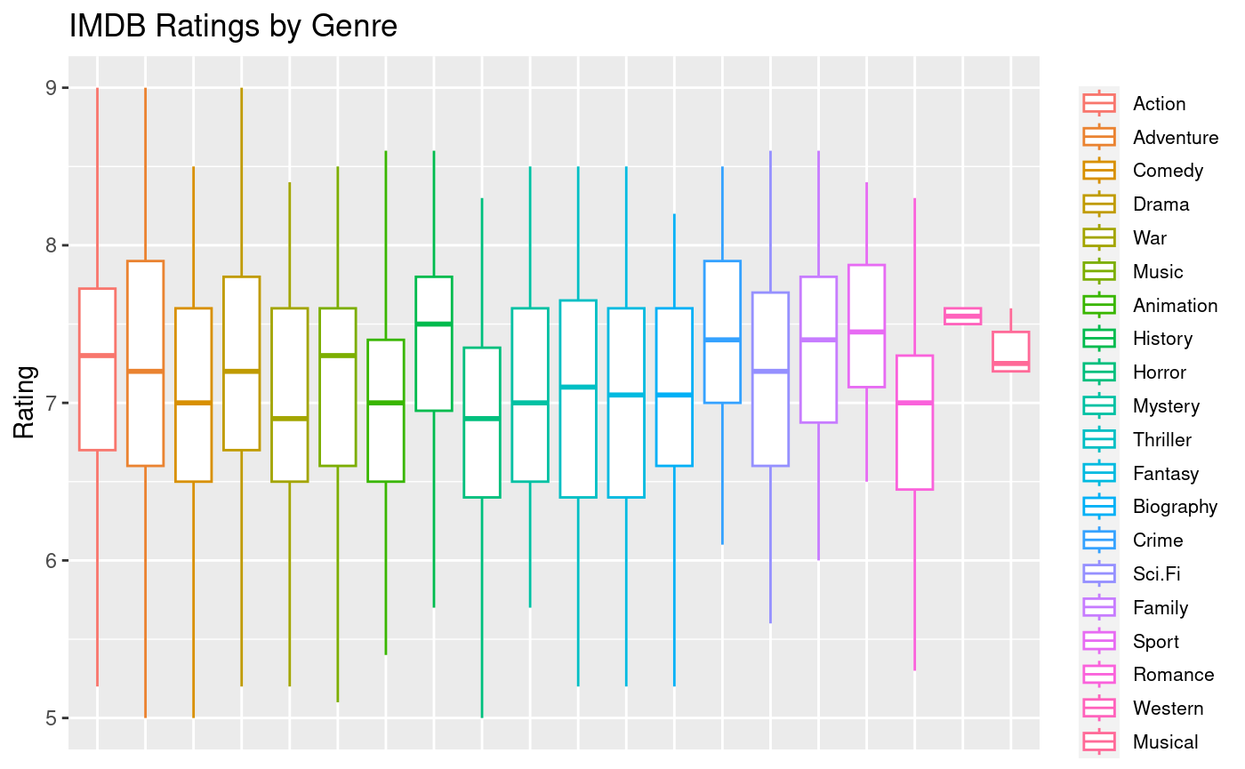
Exploratory Data Analysis

Slide 6
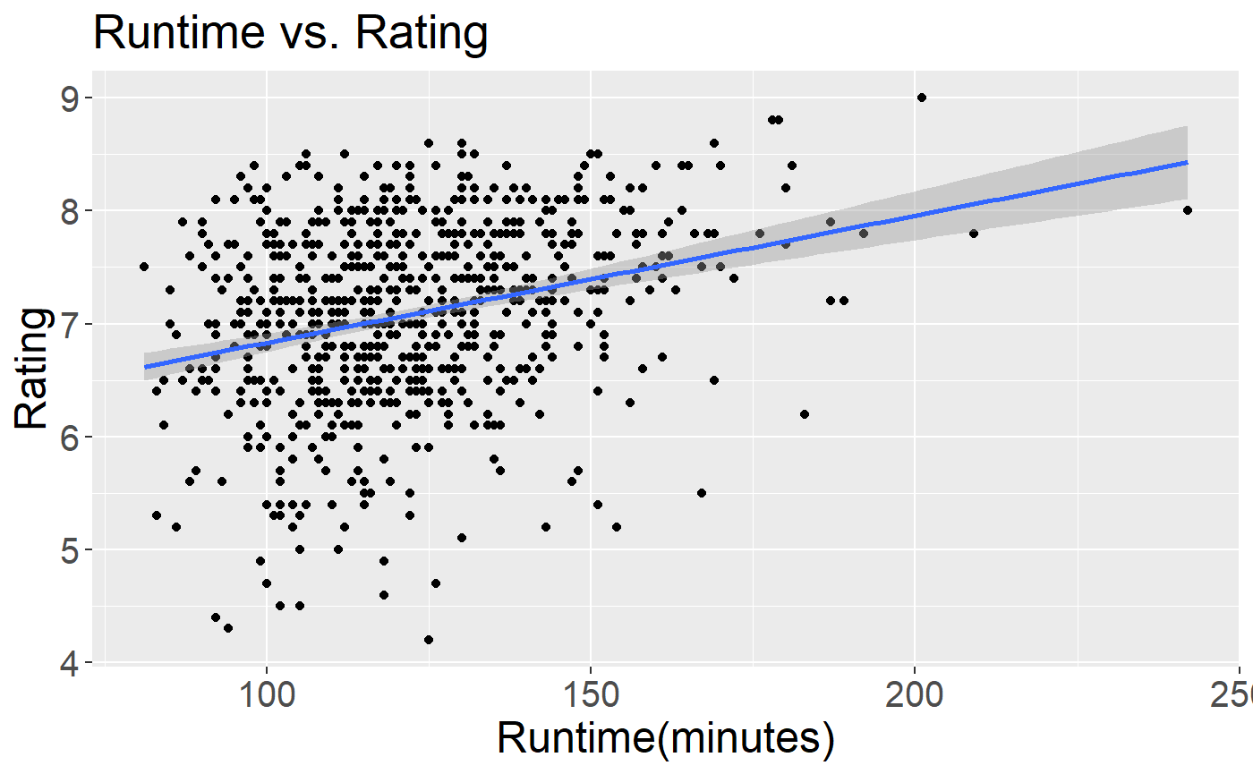
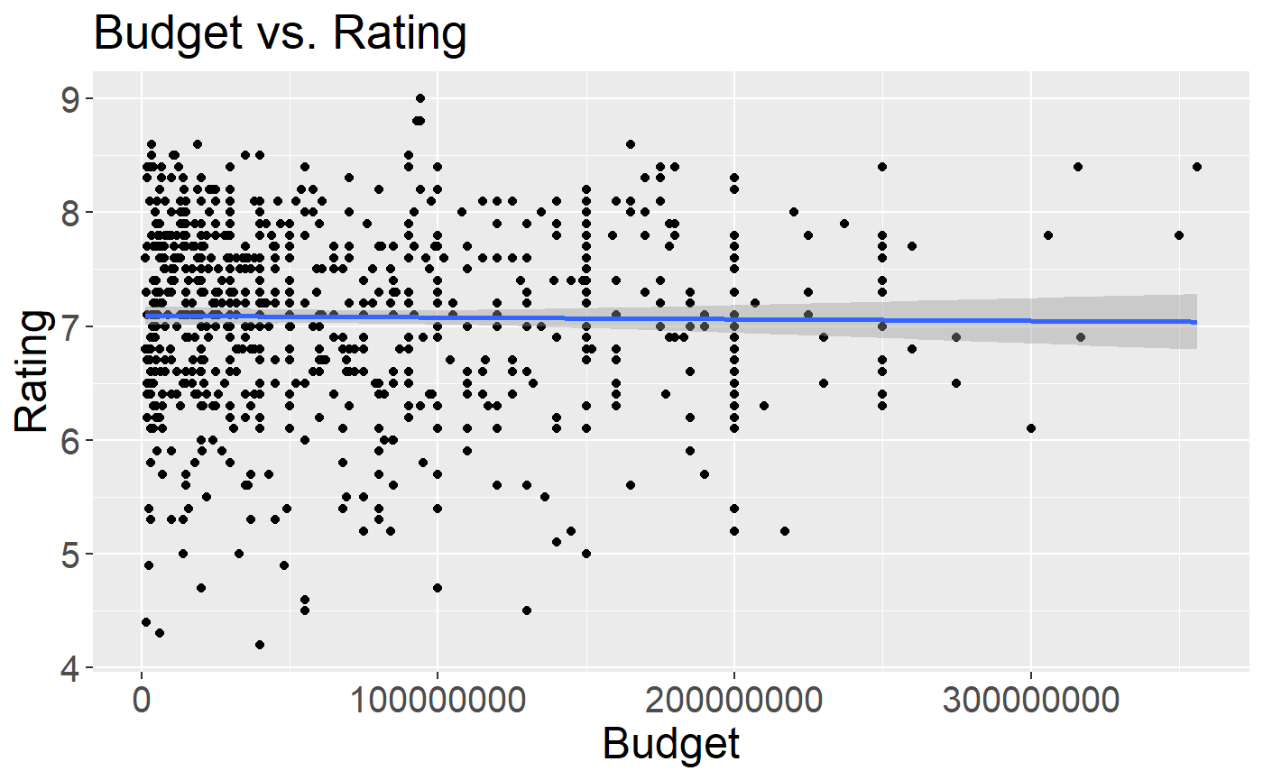
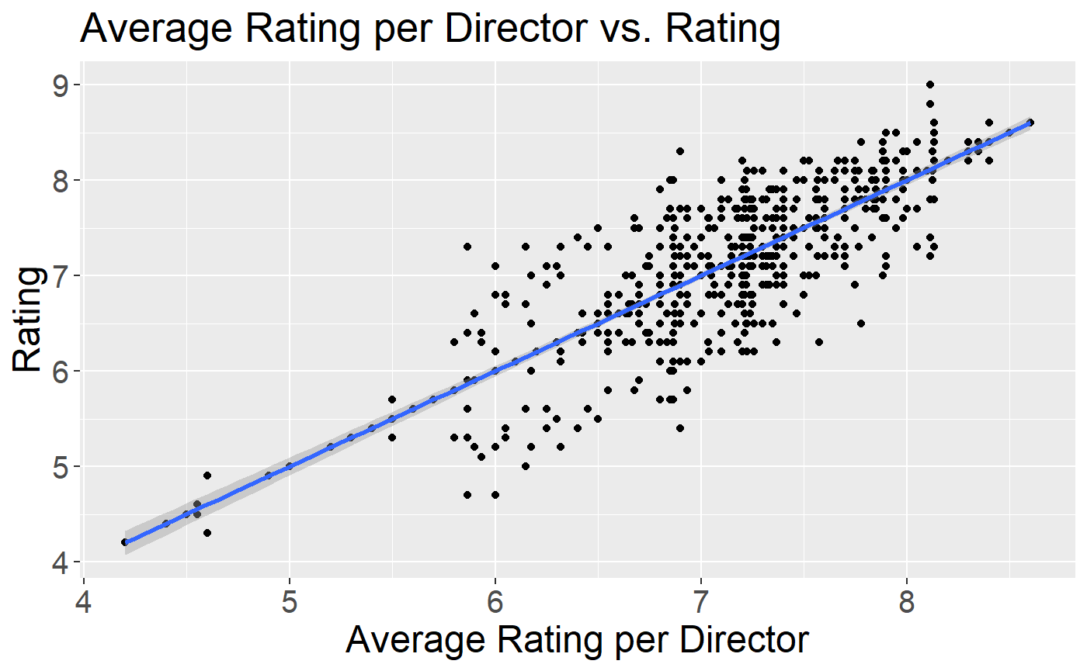
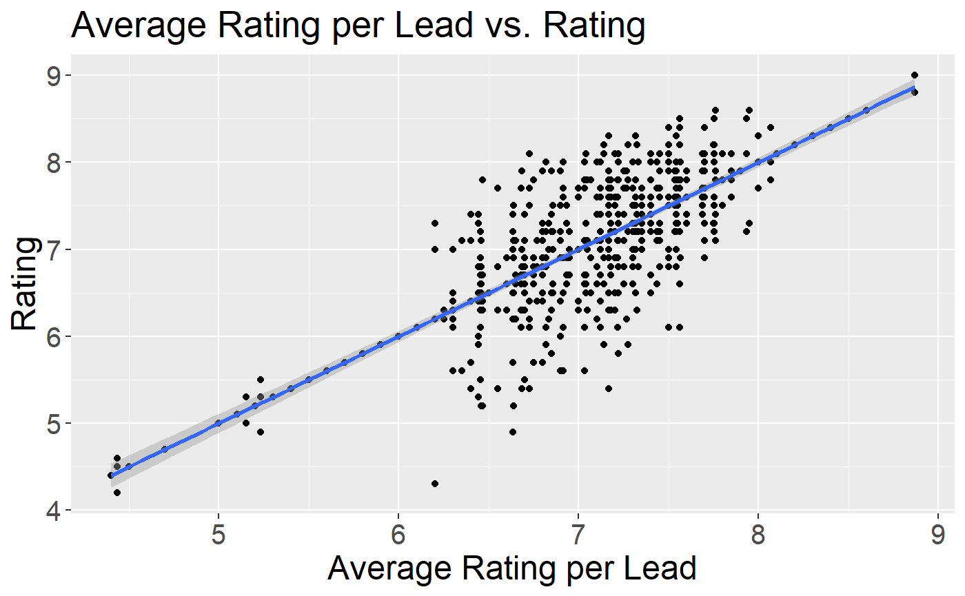
Scatterplots for Numeric Predictors

Slide 7
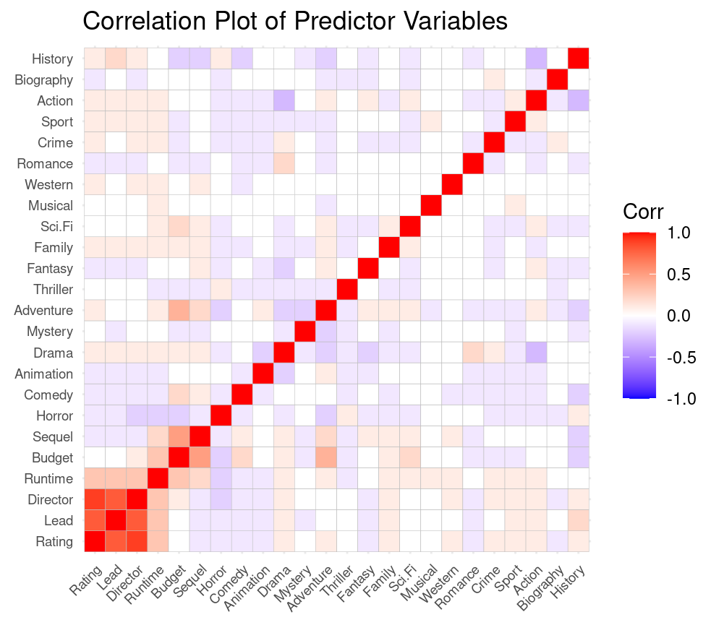
MLR, Ridge, and LASSO Regression
MLR used as baseline model
By introducing bias term, Ridge can shrink coefficients towards zero, Lasso can shrink all the way to zero
May improve models with multicollinearity issues, reduce potential over-fitting
Lasso can also help with large number of variables to produce simpler model

Slide 8
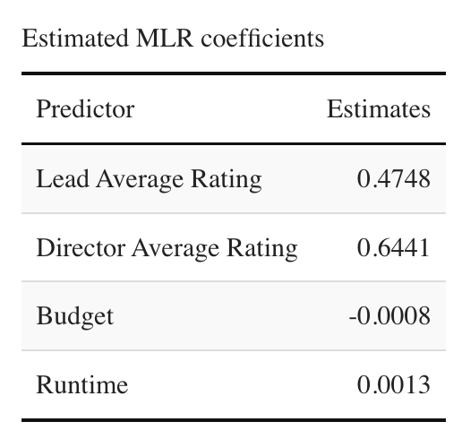
Variable Selection
MLR predictors selected with regsubsets()
Models with interaction terms compared via F-tests
Model with only four variables produced lowest Test RMSE
LASSO shrank all but 11 coefficients to zero
RIDGE had similar RMSE with 28 predictors and the 11 chosen by LASSO
Director and Actor Average Ratings, Budget, and Runtime had by far the largest effects

Slide 9
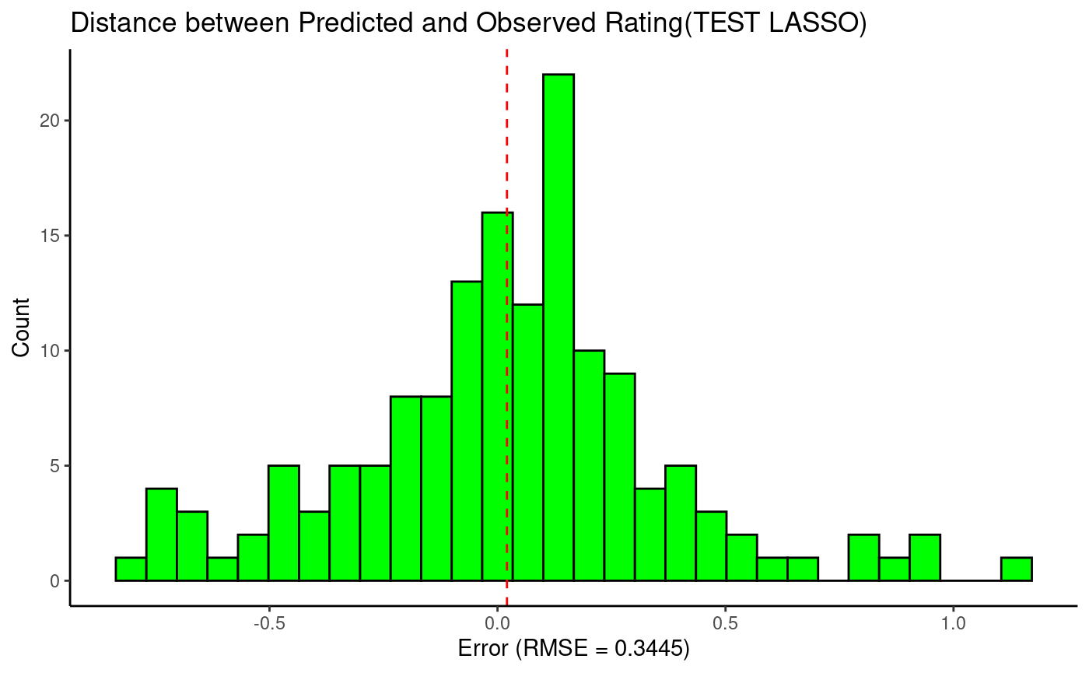
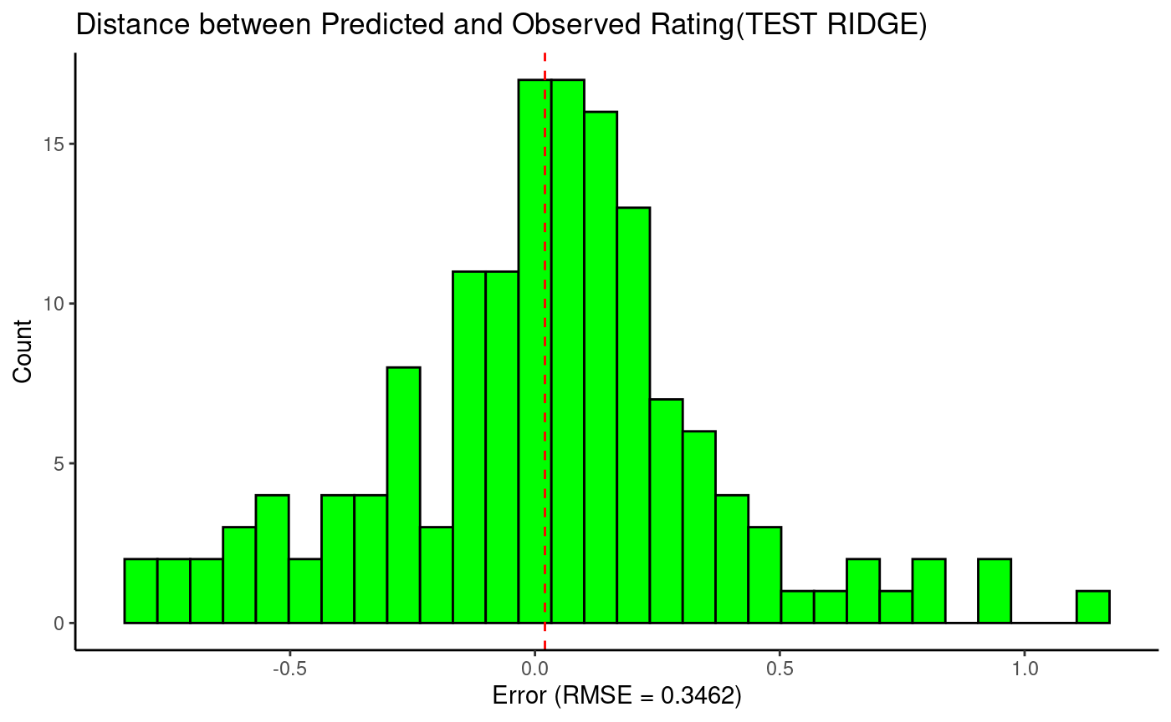
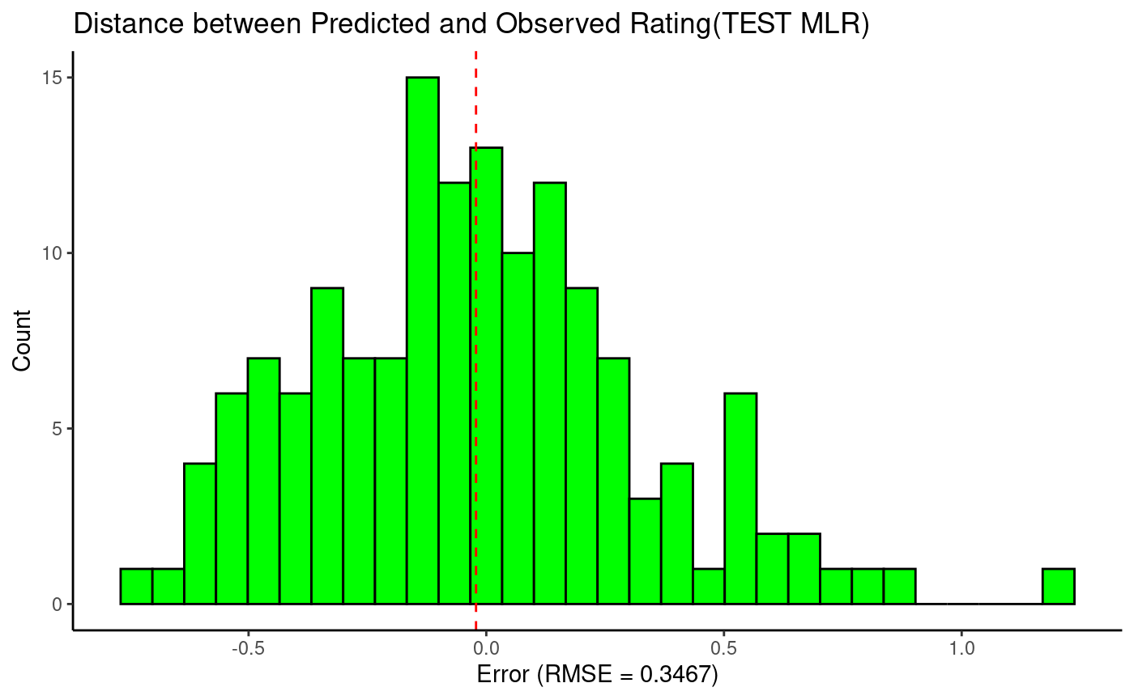
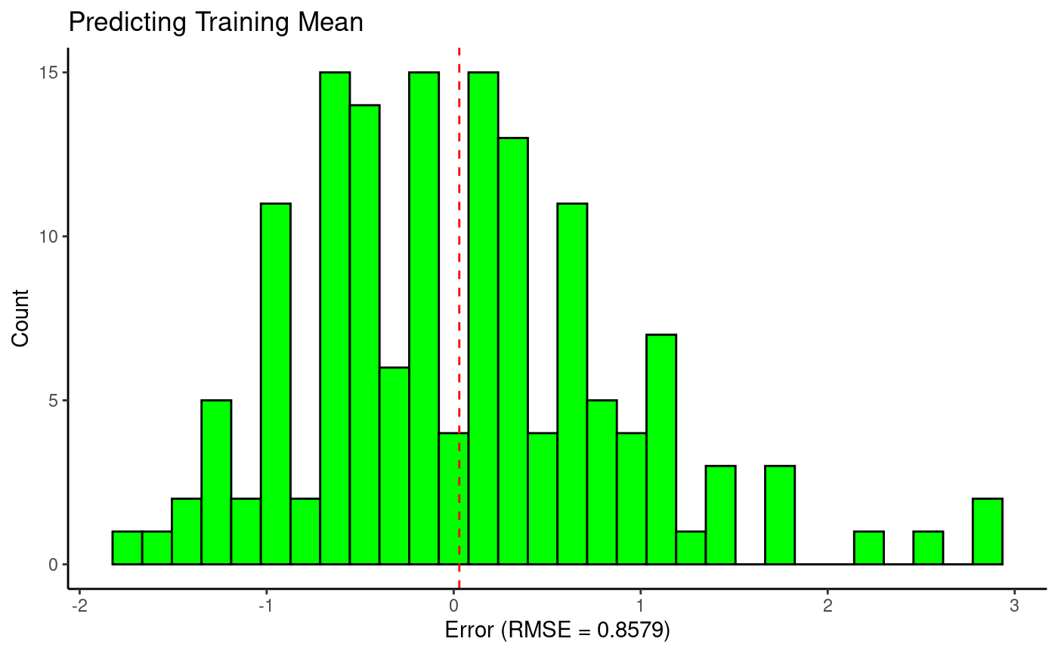
Regression Test Prediction Errors (80/20 split, n = 149)

Slide 10
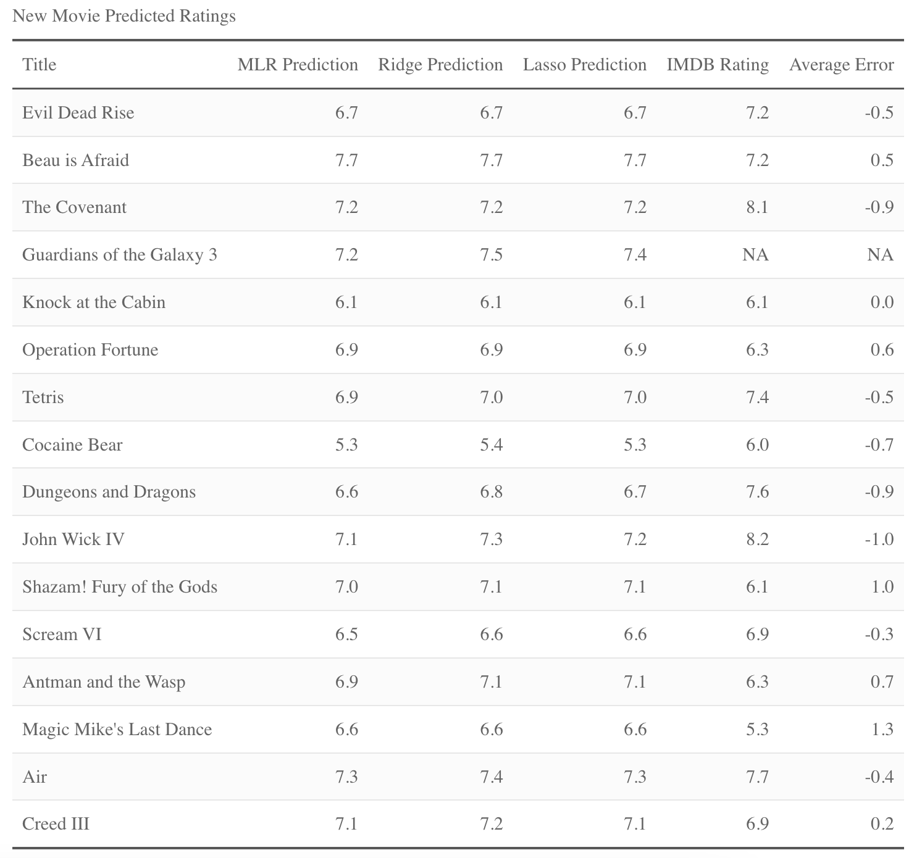
New Movie Predictions
The Regression models performed much worse when predicting on the set of new movies
New Movie Prediction RMSE:
MLR: 0.717
Ridge: 0.702
Lasso: 0.712
Predicting Mean: 0.849

Slide 11
Thoughts on Decreased Regression Performance
Despite taking average ratings, data may still suffer from a lack of information
“Average” Director ratings were often a result of a single movie, meaning it may not reflect their entire body of work
Possibly unlucky draws of sequels which performed very differently than their prequels
(John Wick 4, Creed III, Shazam!, Scream VI all had significantly different ratings than their predecessors)
Overall, it seems the models may have been overfit due to a lack of multiple data points for directors and actors
These two predictors had by far the largest influence

Slide 12
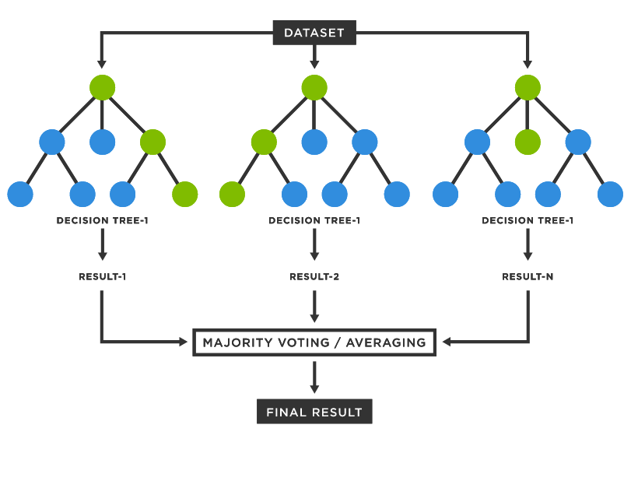
Random Forest Model
Machine learning prediction model consisting of multiple decision trees
Measures predictor importance in estimating the response
Can be used for classification along with numerical predictions
Exceptional at providing clean estimates with straightforward interpretability

Slide 13
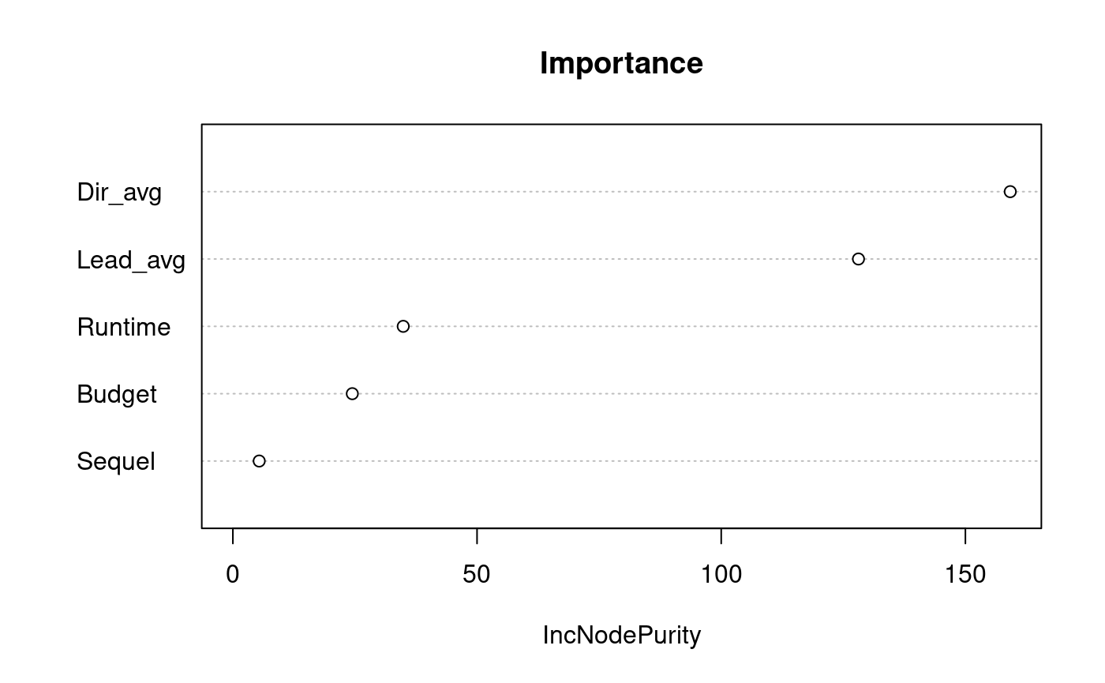
Random Forest Building (Variable Selection)
Obtained genre data but received low model importance and inflated MSE
Director and Lead Average provided high importance, though potentially overfit at times
Runtime, Budget, and Sequel had low importance but were still included in final model

Slide 14
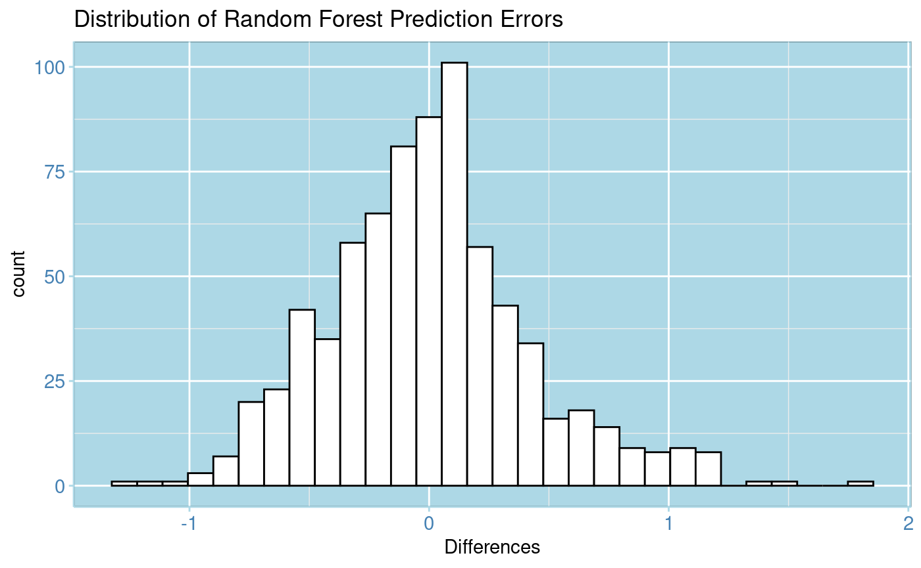
Random Forest Performance (Numeric)
Obtained test RMSE of 0.46
Errors are normally distributed with mean roughly 0

Slide 15
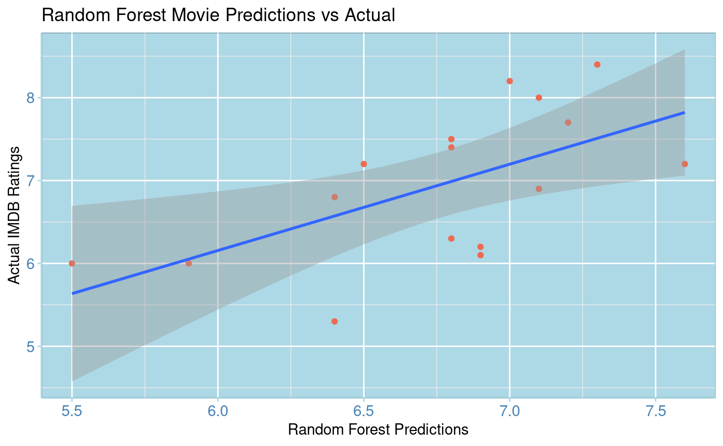
Distribution of Results
Takeaways:
Model performed better on test data than real movies
All predictions relatively close to actual ratings, though none were spot on

Slide 16
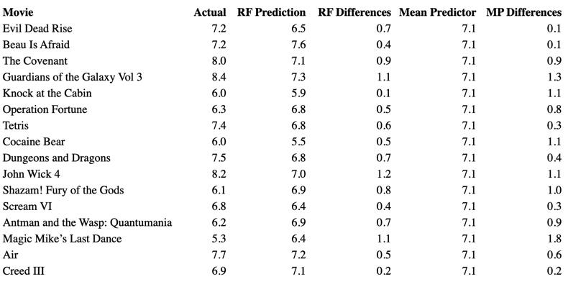
Comparing to Mean Predictor
Average Differences:
Mean Predictor
0.79
RF Predictor
0.65

Slide 17
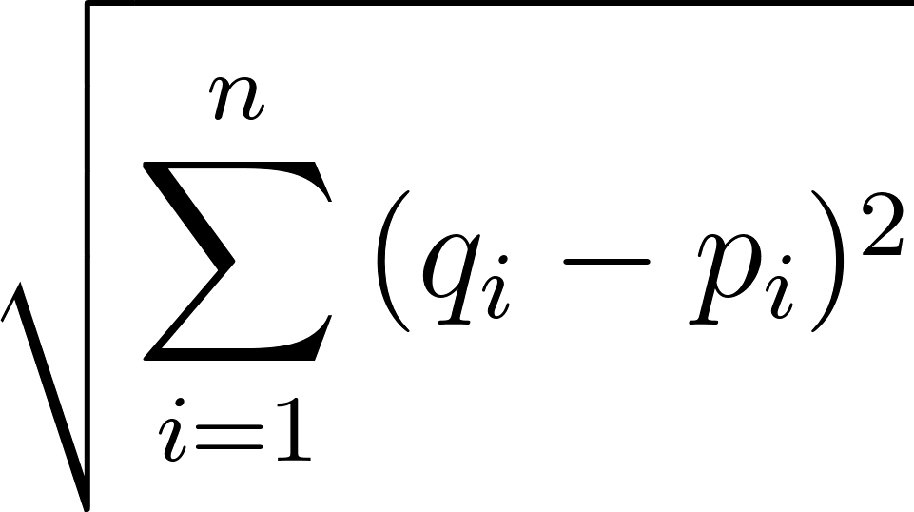
K-Nearest Neighbors(KNN)
What is KNN?
Machine Learning Technique that uses euclidean distance
(distance between a new data point and the neighboring points around)
Does not make any assumptions about the data and also works well with smaller datasets.

Slide 18
KNN Process
Was used to predict IMDB ratings on new movies premiering in 2023
Used 310 movies for my training set, test set was 9 new movies
Tried out categorical response(did not really work)
Went with numeric response (regular ratings)
Left out genres and sequel for predictors, only included runtime(minutes), budget(in millions), average rating per director, and average rating per lead
Used a for-loop for 1-28 for # of neighbors, picked 5 as K based on RMSE

Slide 19
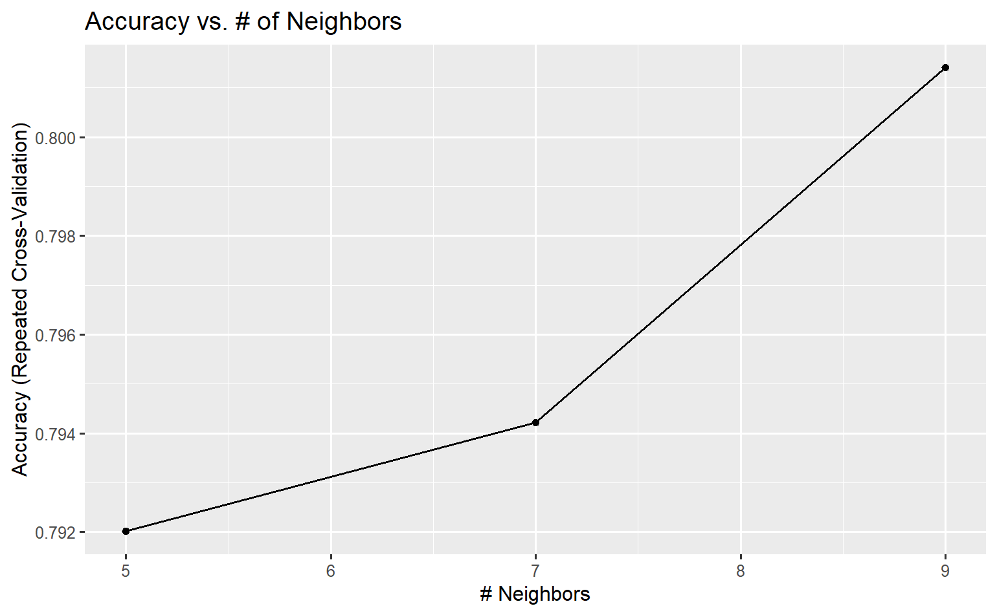
Categorical Response KNN
Categorized ratings/director ratings/lead ratings from
4 < Rating <= 6 as “1” or “Ok”
6 < Rating <= 8 as “2” or “Good”
8 < Rating <= 10 as “3” or “Great”
RMSE was 0.57

Slide 20
Numerical Response KNN(failed)
I had used 13 movies for my test set(original 9 and then 4 more)
I tried different combinations with this set of movies, but kept getting only 2 different predictions for ratings. (7.0 & 7.5, 6.8 & 7.0)
I decided that this was not a good representation of predictions and that it did not make much sense
I went with the original 9 movies.

Slide 21
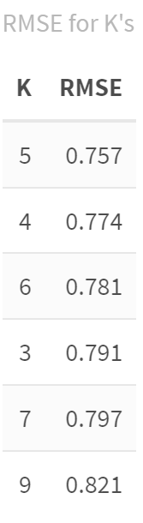
Numerical Response KNN
From before, I picked 5 for my K (# of nearest neighbors)
Predictors used were ones mentioned before
Had an RMSE of 0.757

Slide 22
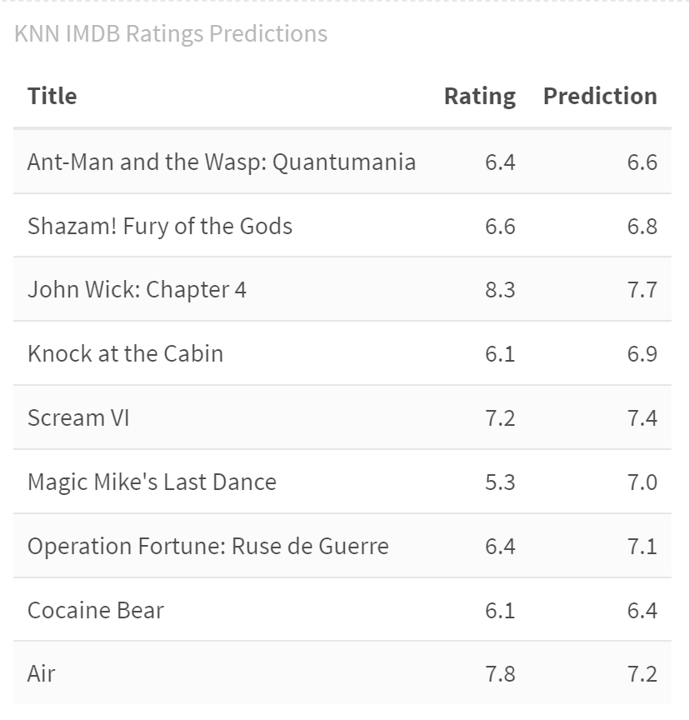
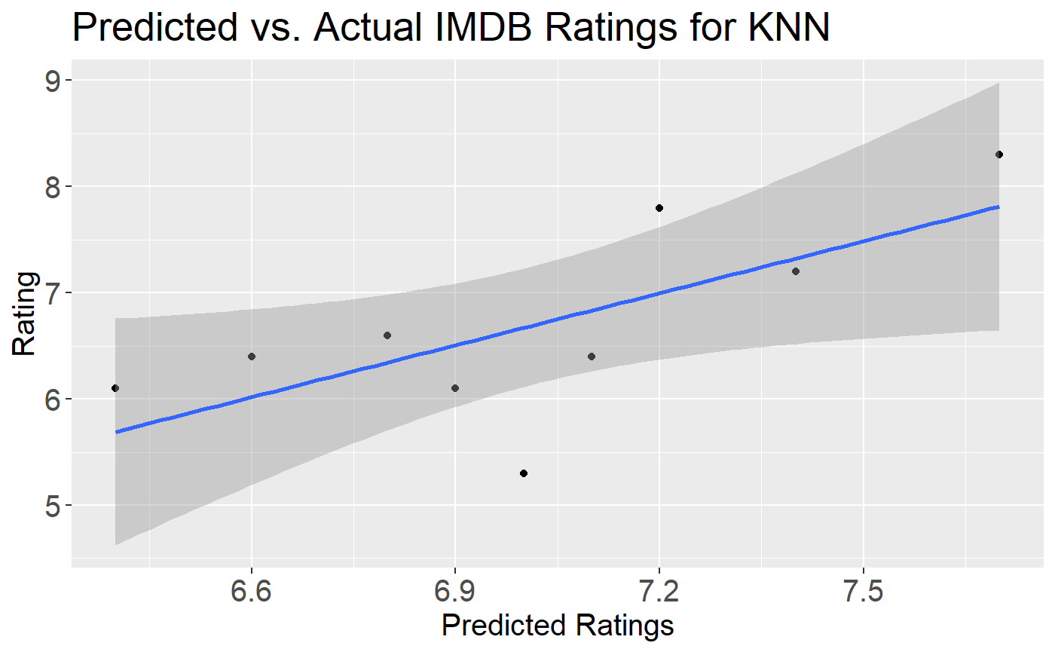
KNN Predictions

Slide 23
Final Model Comparisons
Regression performed well on test data, poorly on new movies
Random Forest performed well on test data but failed to make as accurate predictions on new movies
KNN did not perform as well as the other methods, based on RMSE and what happened when new movies were added to predict on.

